Slide 1
Status update

Slide 2
Things I’ve done
Gotten further with hugging face course
Doing right now
Trying to implement what I’ve learned in python

Slide 3
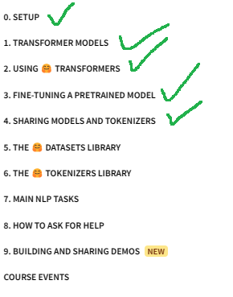

Slide 4
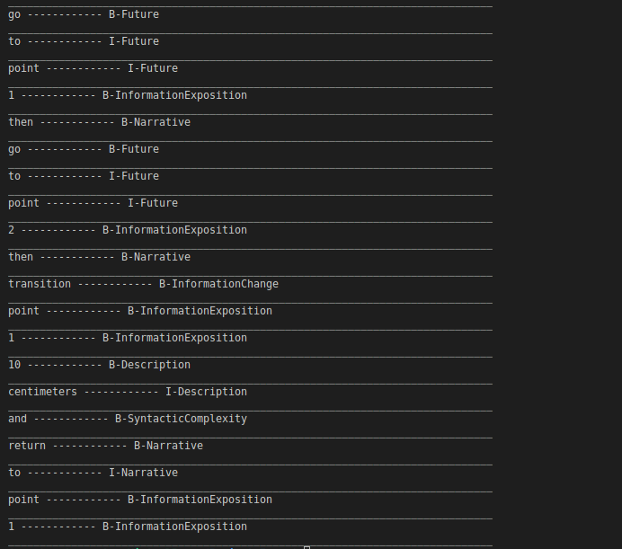

Slide 5
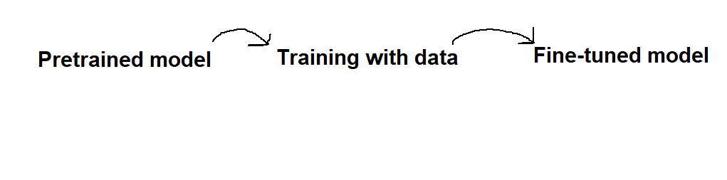
Overview of my plans specified

Slide 6
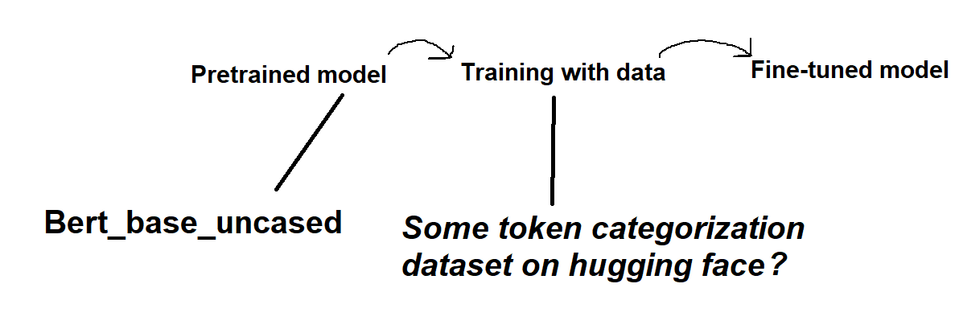
Overview of my plans specified
DistilBert_base_uncased

Slide 7
Possible datasets.
conll2003 · Datasets at Hugging Face
strombergnlp/twitter_pos · Datasets at Hugging Face:
Does not tell what the pos tag values mean

